Slide 1
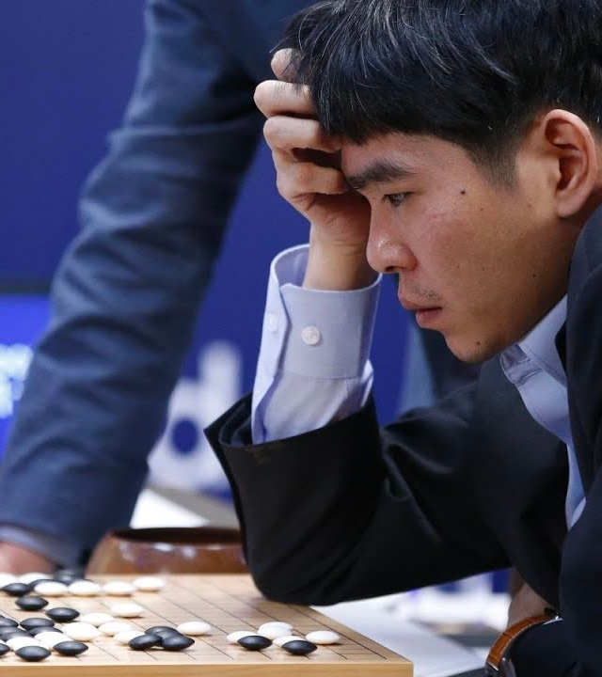
29.04.2022
Reinforcement Learning and its Applications

Slide 2
Outline:
Introduction
what, objectives, why
Applications
Q-learning overview
Travelling Salesman Problem
Blackjack
Job-Shop Scheduling
Problems statement
Deep Q-learning Architecture
Results
Future Works
29.04.2022
1

Slide 3
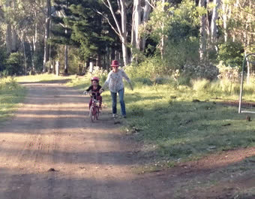
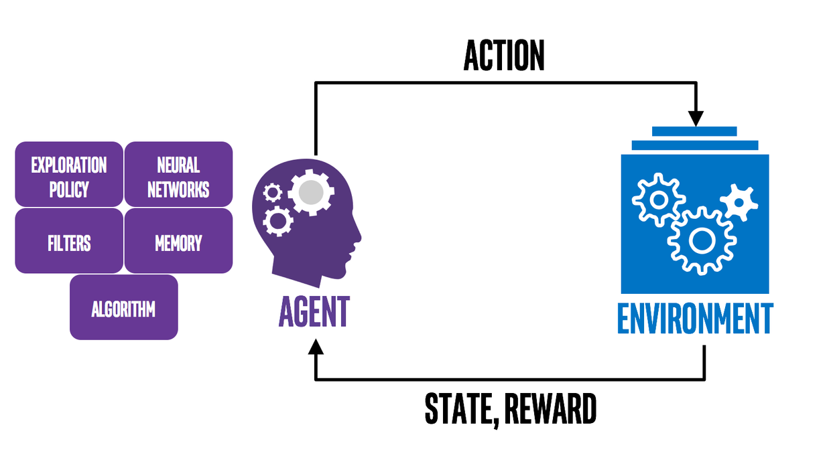
1.a. Reinforcement Learning in a Nutshell
Introduction
Learning to ride a bike requires trial and error, much like reinforcement learning.
A learning agent: A kid learns bike
A learning algorithm: Parents
Environment: Bike, road, trials (success, fail) ...
https://nervanasystems.github.io/coach)
(developer.nvidia.com)
29.04.2022
2
Notes:
It is very difficult to explain to a child how to ride a bike, and even a good explanation makes little sense to someone who has never ridden before: you have to get the feel for it. In a reinforcement learning problem, we take the view of an agent that tries to maximize the reward that it is receiving from making decisions. An agent is an abstract entity which can be any kind of object or subject that performs actions. Just like in the bike-riding example, the reinforcement algorithm has only two sources of feedback to learn from: penalty (pain of falling) and reward (thrill of riding for a few meters). This is reinforcement learning in a nutshell.

Slide 4
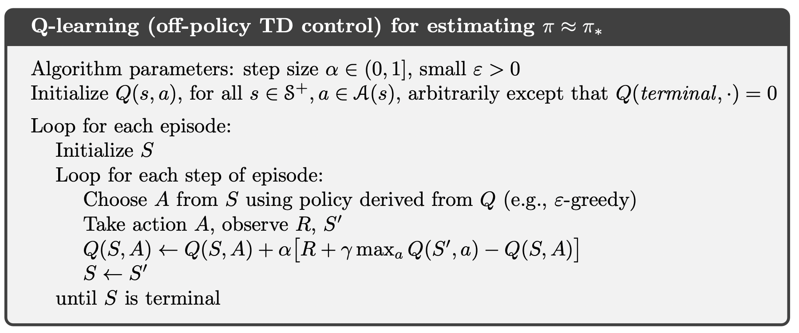
2.a. Q-Learning
Applications
One of the early breakthroughs in Reinforcement Learning was the development of an algorithm called Q-Learning (Watkins, 1989), defined by:
29.04.2022
5

Slide 5
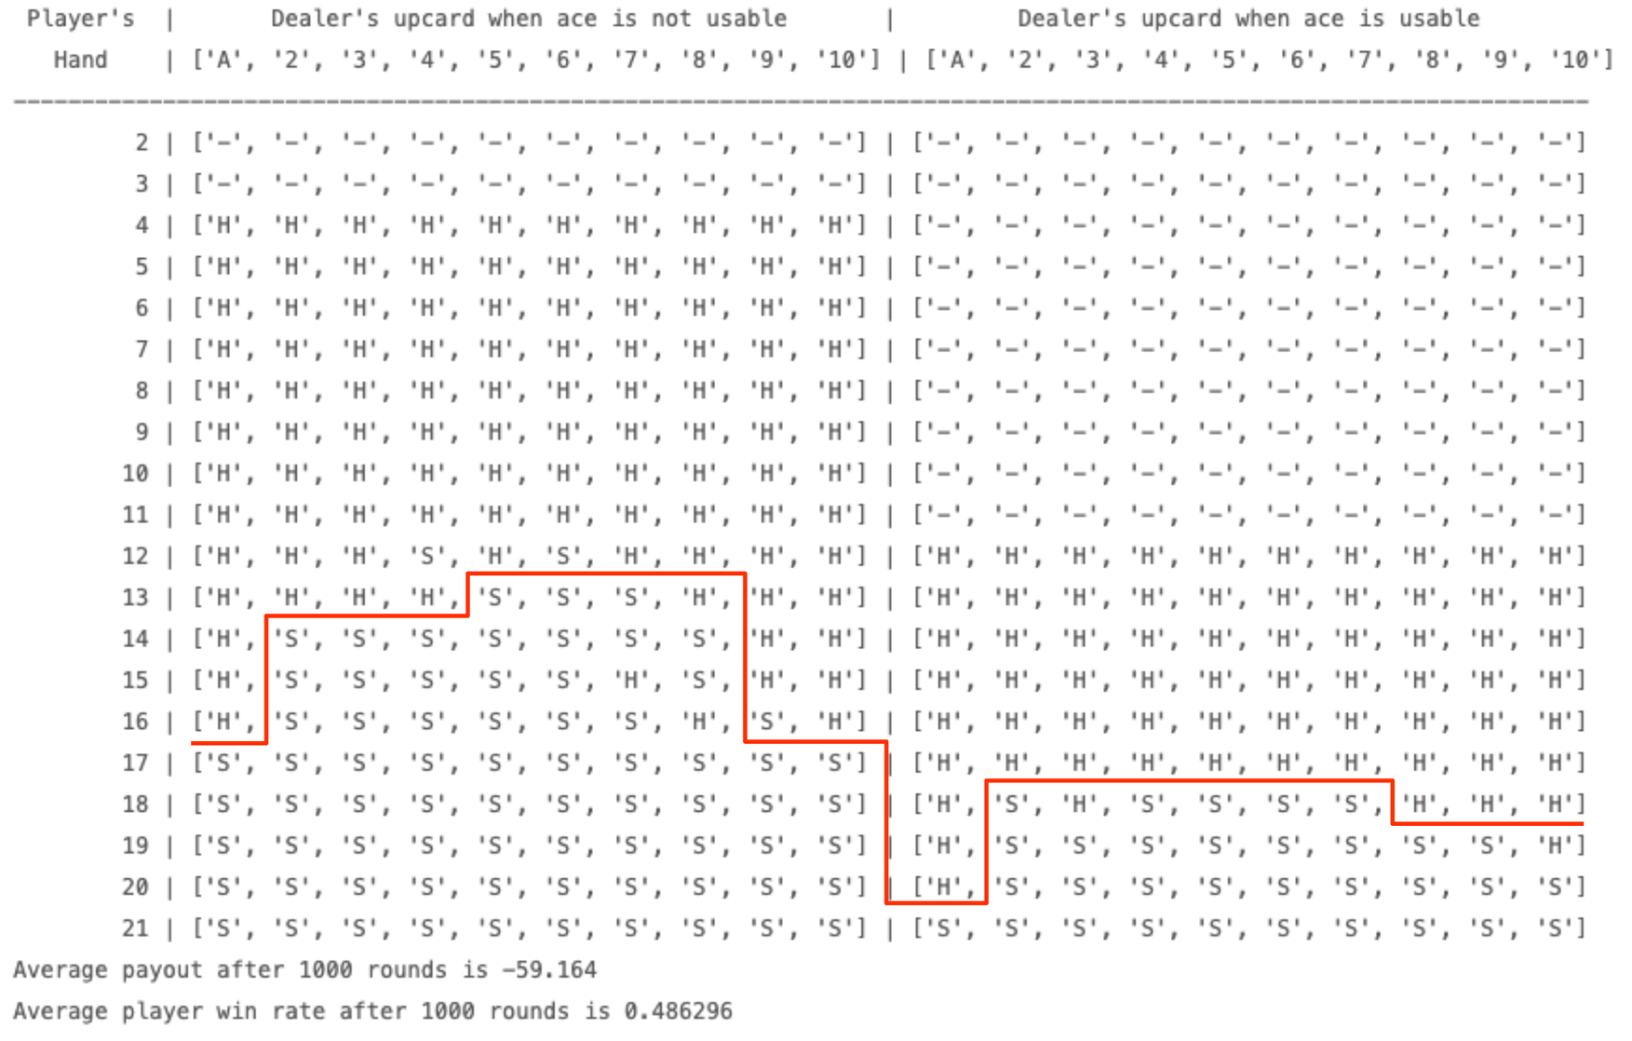
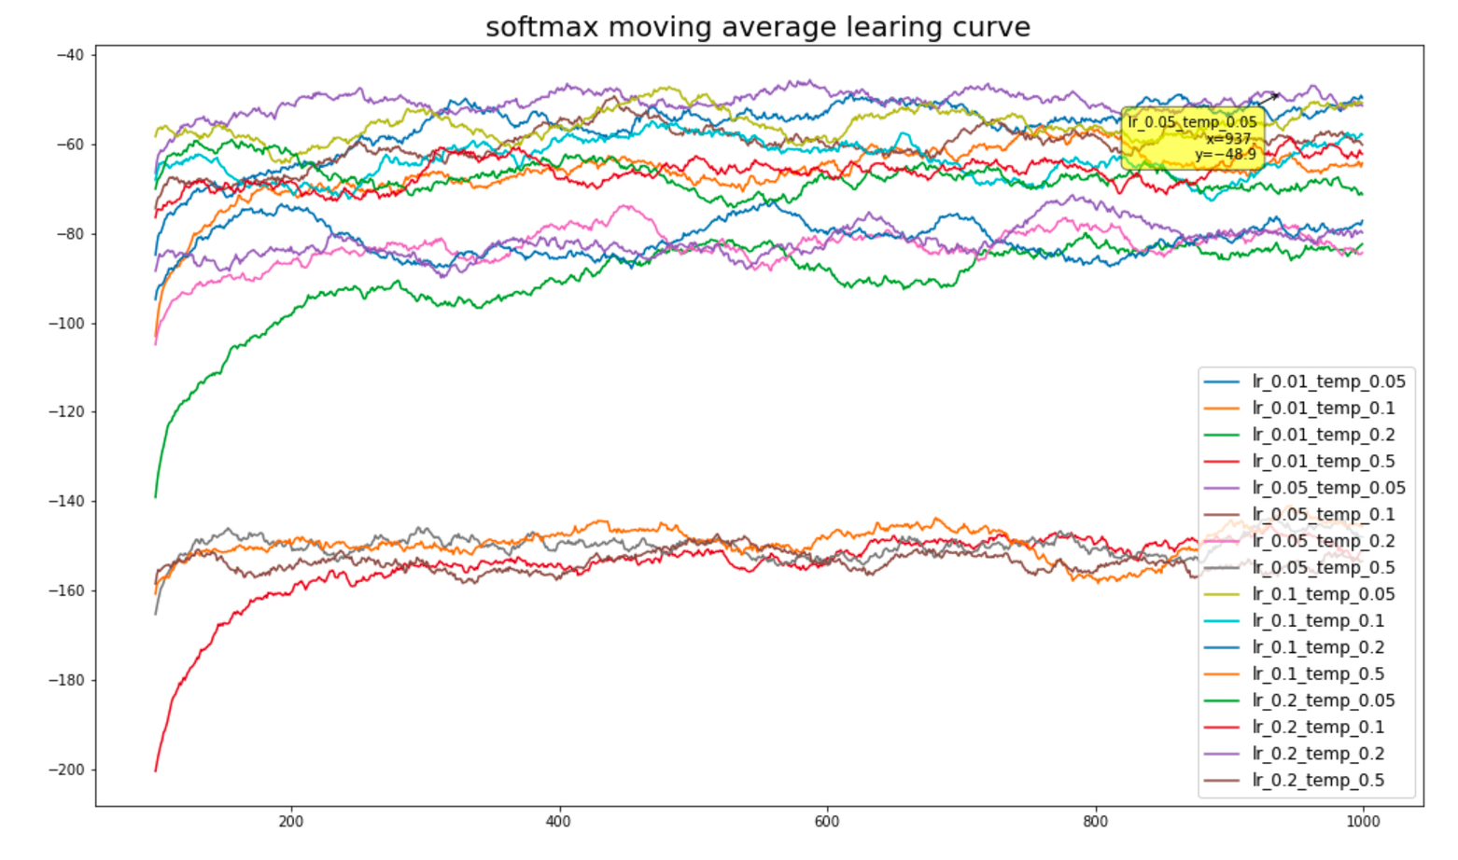
2.b. Blackjack Game (Q-Learning)
Applications
Goal: Obtain cards the sum of whose numerical values is as great as possible without exceeding 21
29.04.2022
6

Slide 6
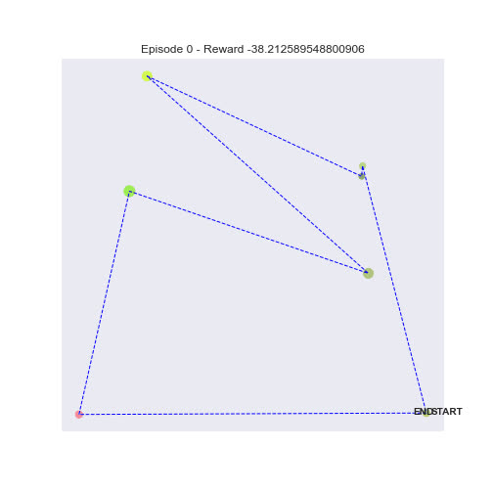
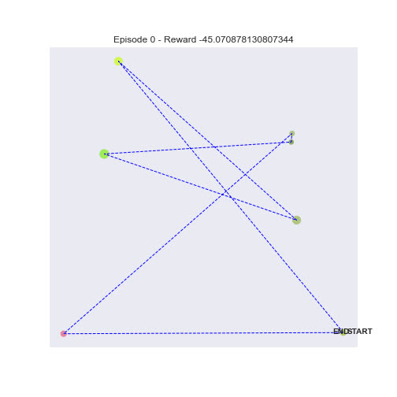
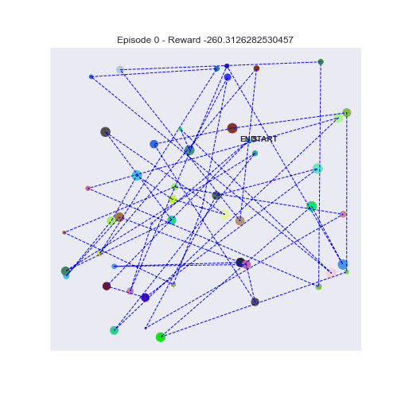
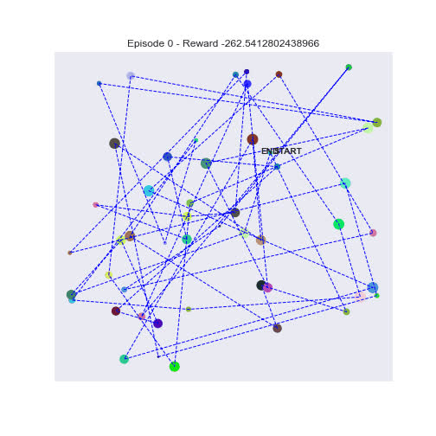
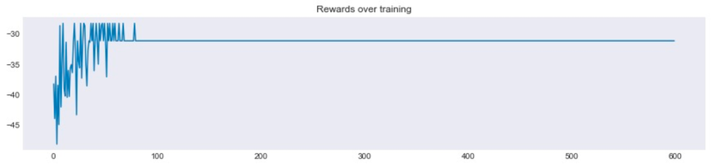
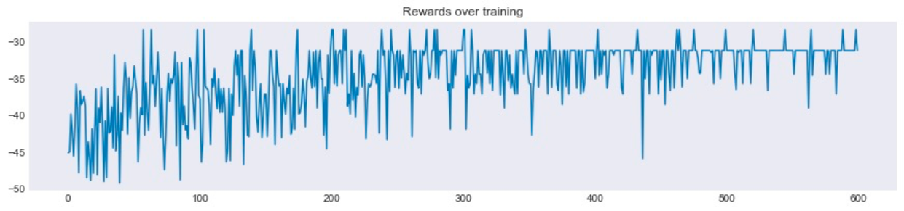
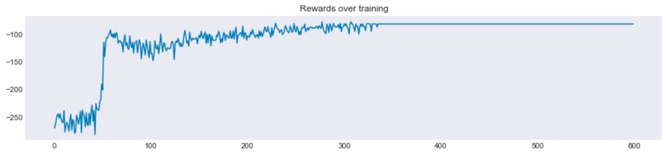
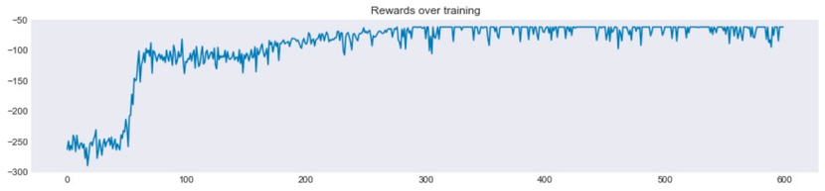

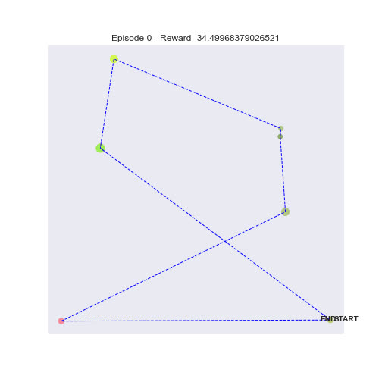
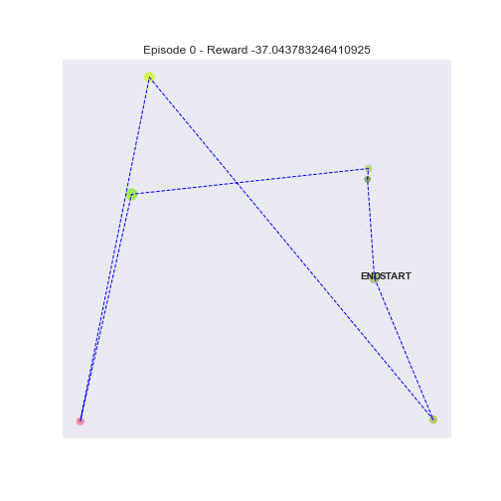
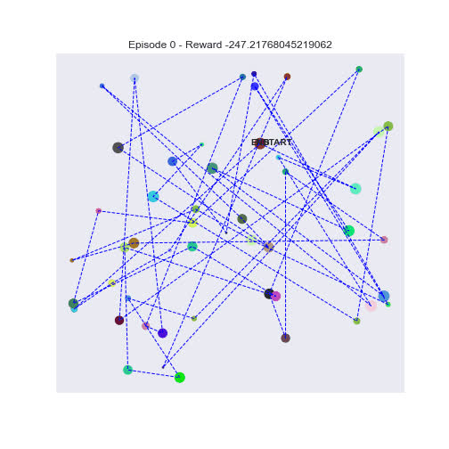
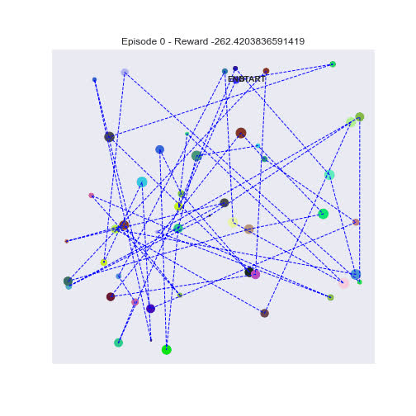
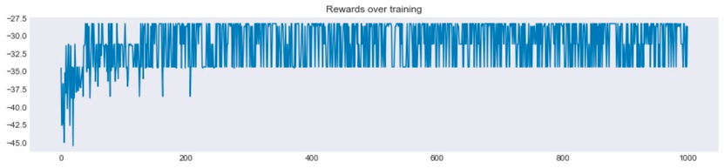
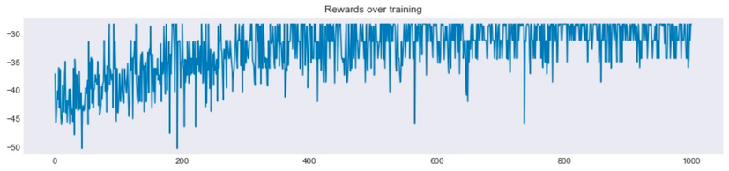
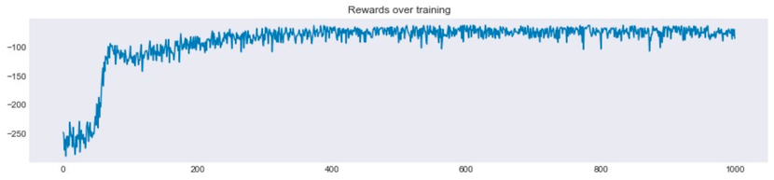

2.c. Travelling Salesman Problem (Q-Learning)
Applications
Setup:
7 Cities
50 Cities
Goal
find the best possible route that visits all cities with minimal distance and returns to the origin city.
Fixed start city
State (observation)
Current city
Action
All other cities except the current city
Reward function
Reward -= distance
Stop condition
Visited all locations
Random start city
29.04.2022
7

Slide 7
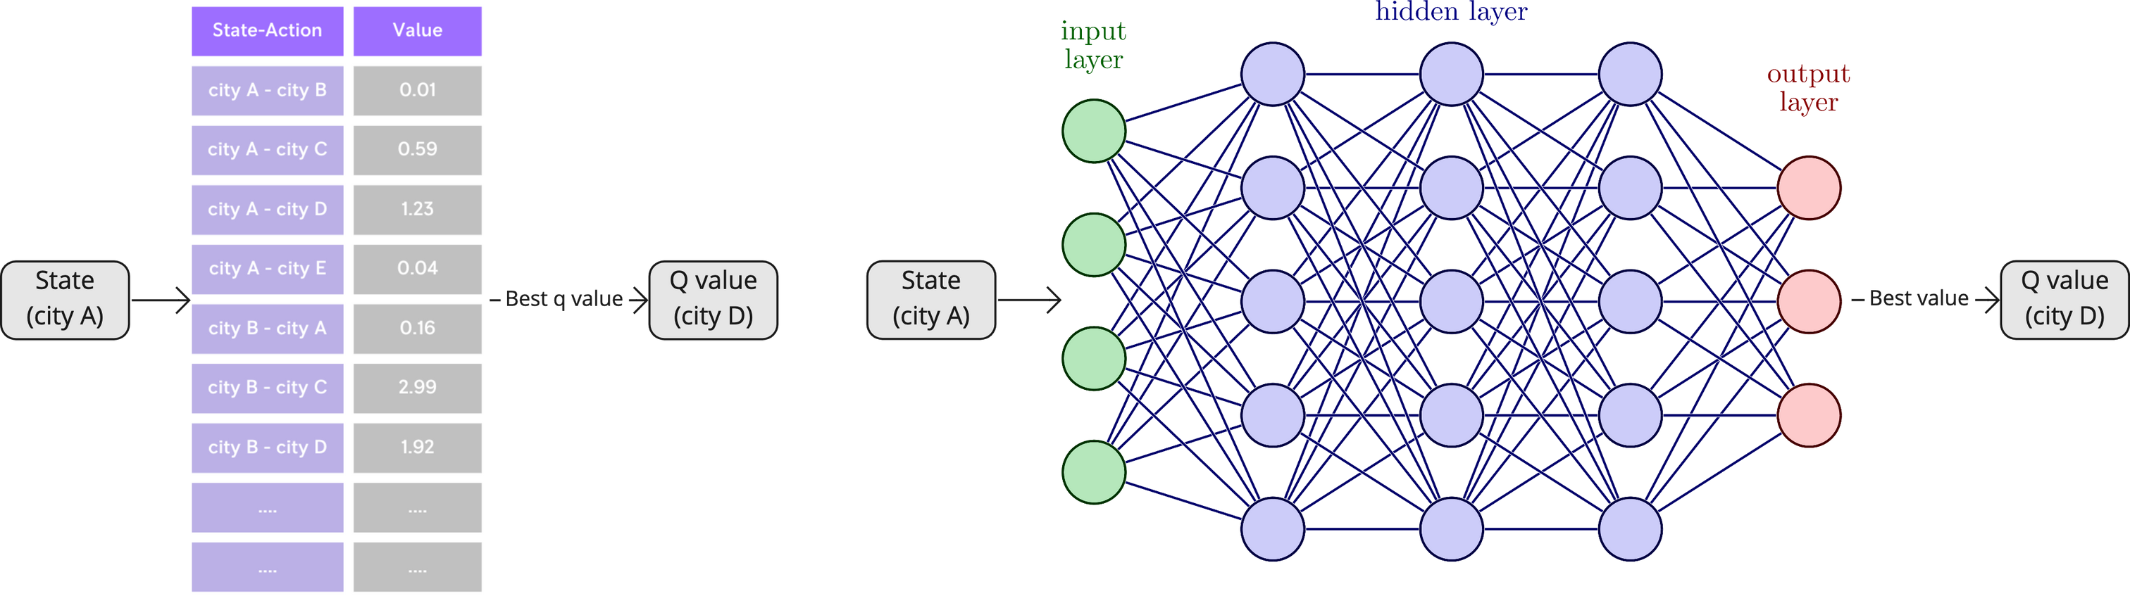
2.c. Travelling Salesman Problem (Q-Learning)
Applications
What if Q table reach infinity size?
Q Table
Deep Q-Neural Network
29.04.2022
8
Notes:
TSP is simple, we can compute every possible (state -> action)
what if simulate the real world (too complicated)
NN:
infinite approximation

Slide 8
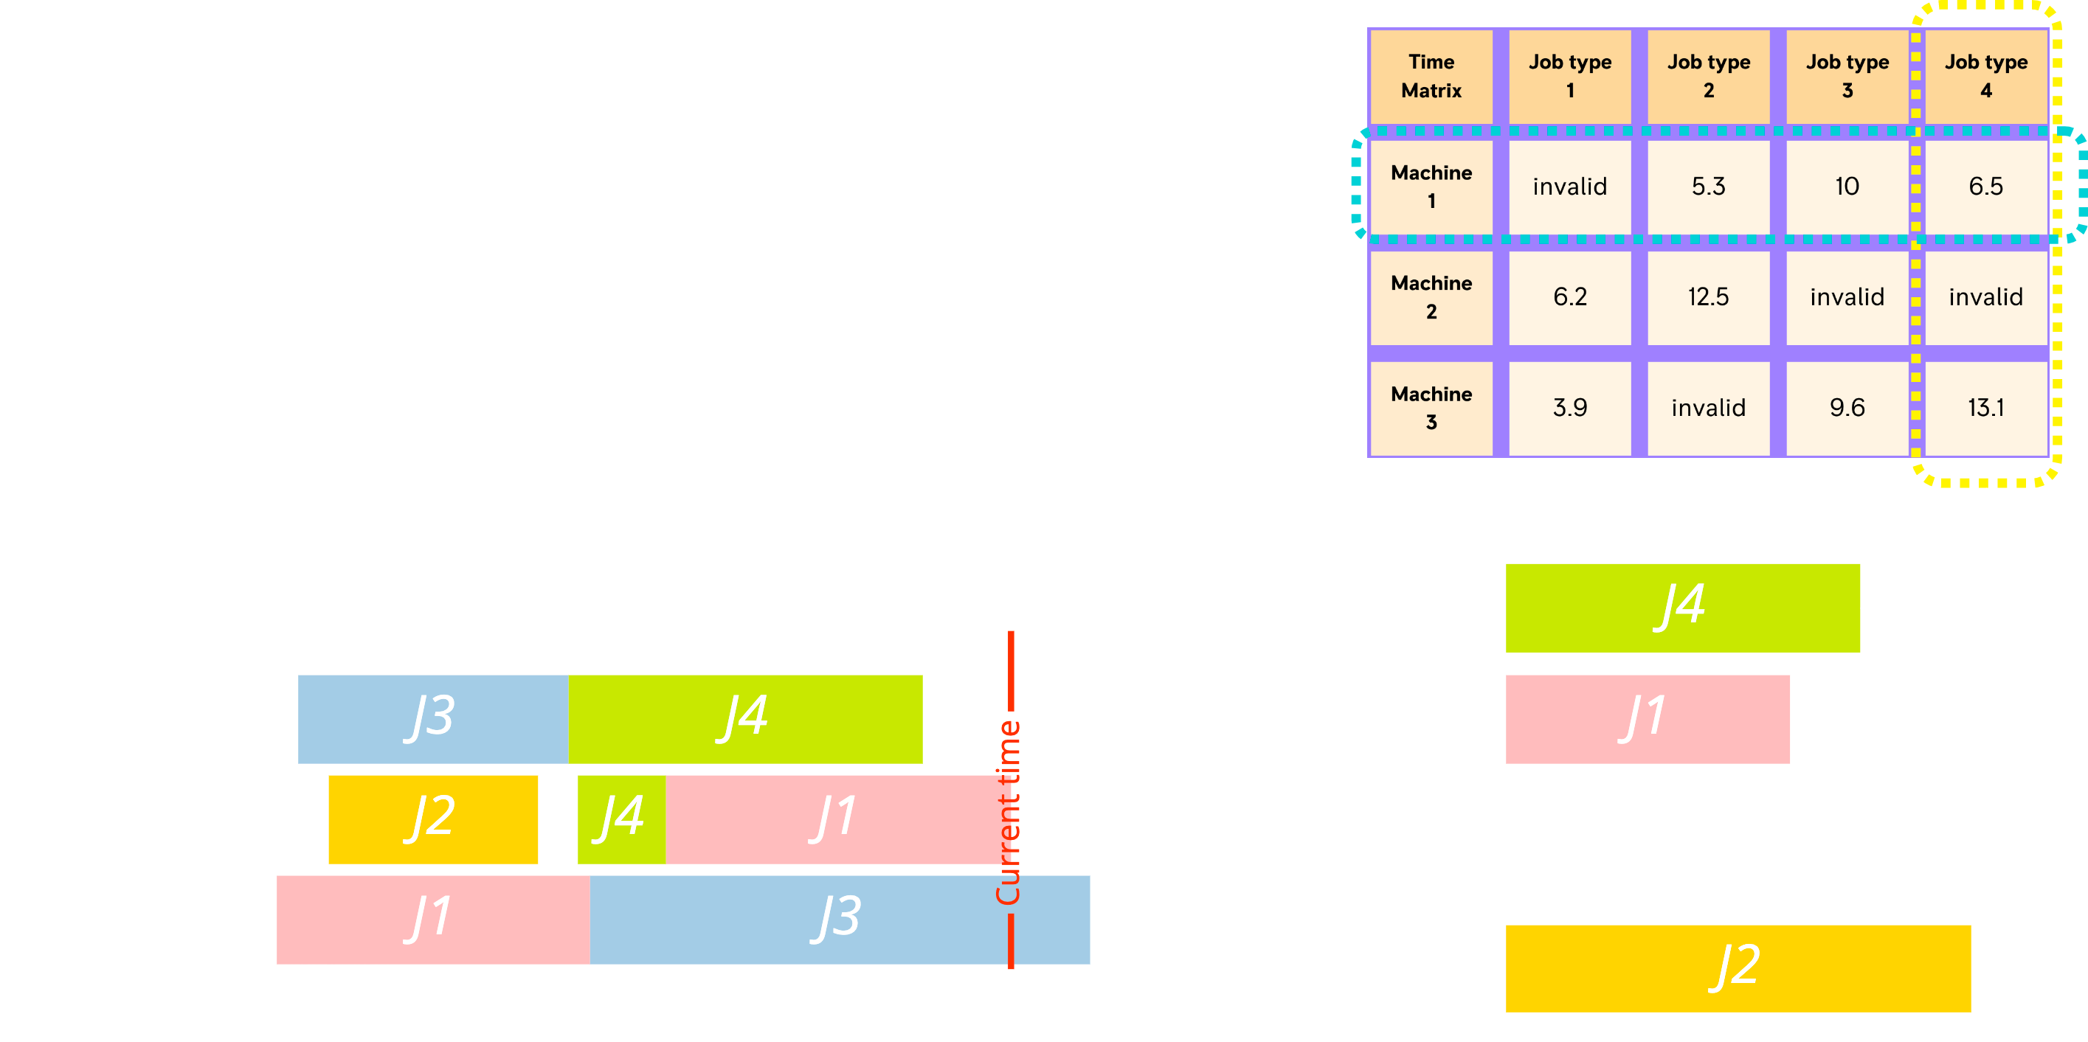
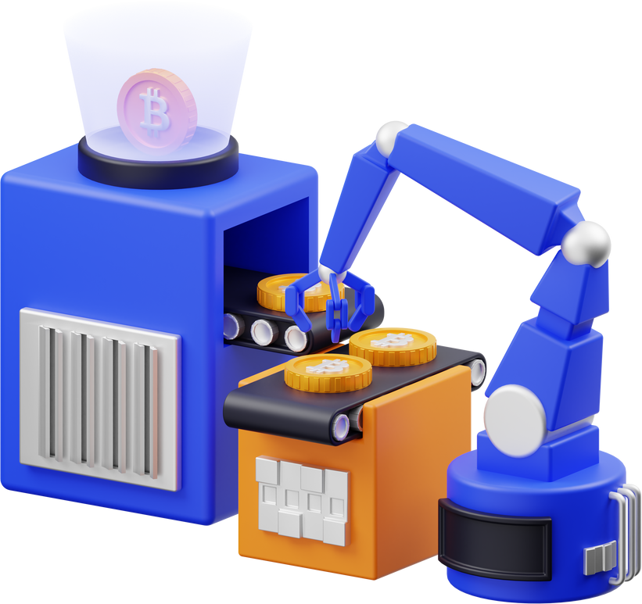
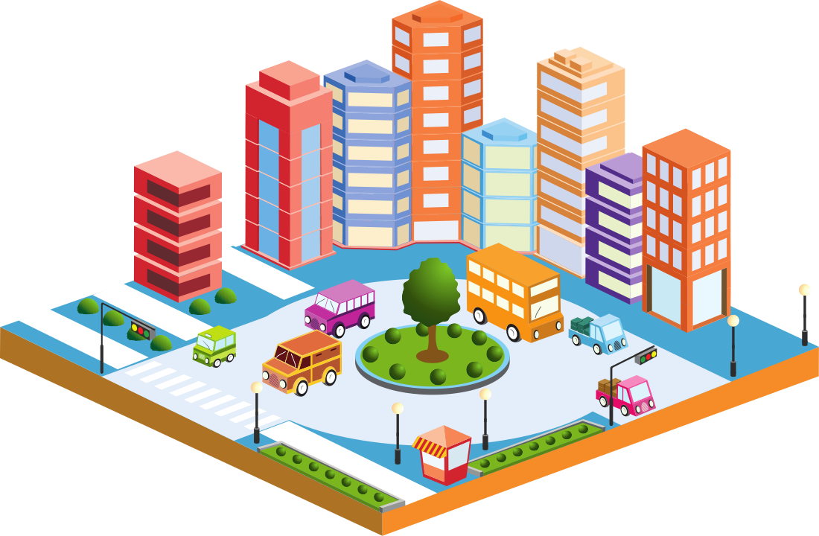

2.d. Job-Shop Scheduling Problem Statement (Deep Q-Network)
Applications
Manufacturing
Transportation
Supply chain
29.04.2022
9

Slide 9
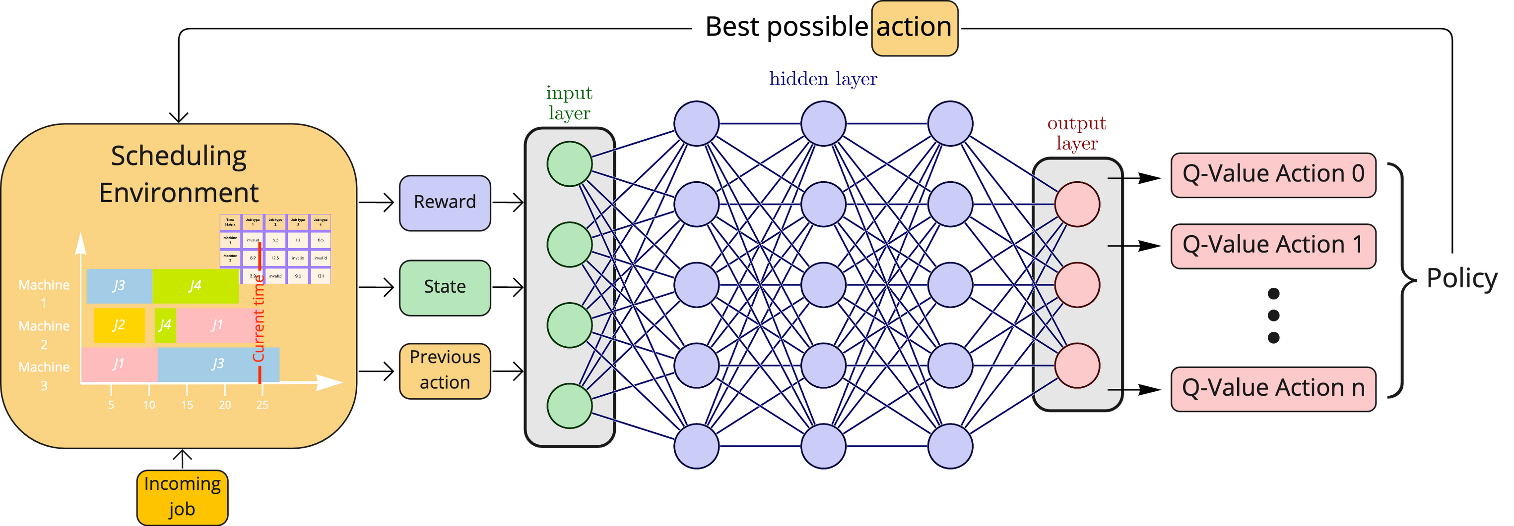
2.d. Job-Shop Scheduling Architecture (Deep Q-Network)
Applications
Reward
State
Action space
Constrain
Machine efficiency ratio
(0%-100%)
Machine status vector + job process time vector [2*m]
All available machines
[size: number of machines]
If a job reach its max waiting time, give it up
29.04.2022
10
Notes:
State: How much time job n should be processed on different machines

Slide 10
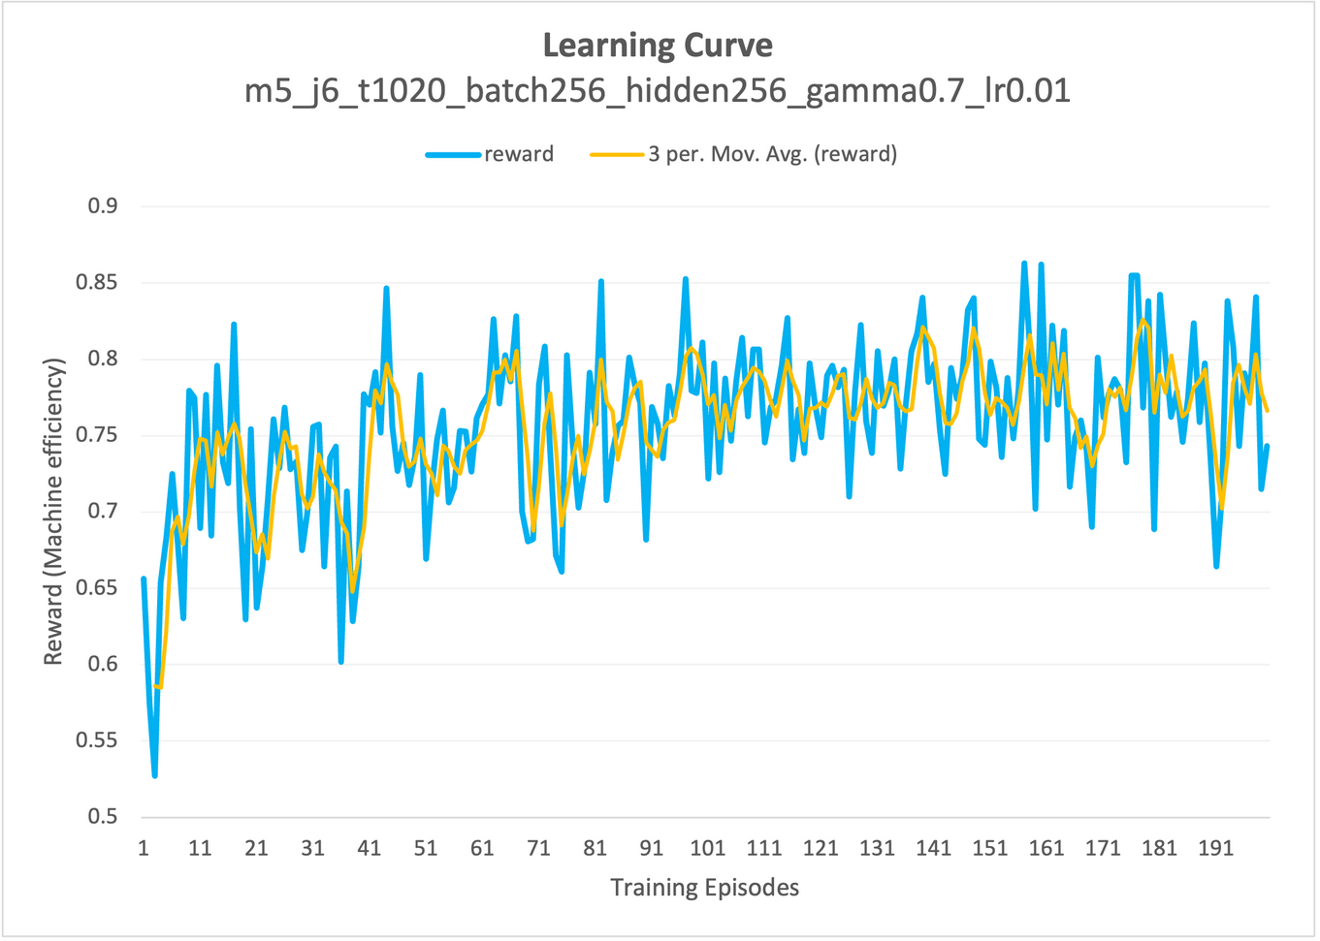
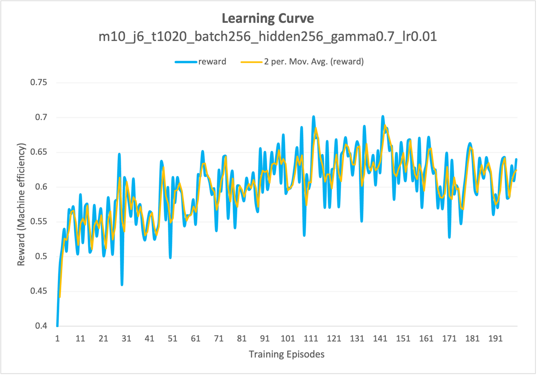
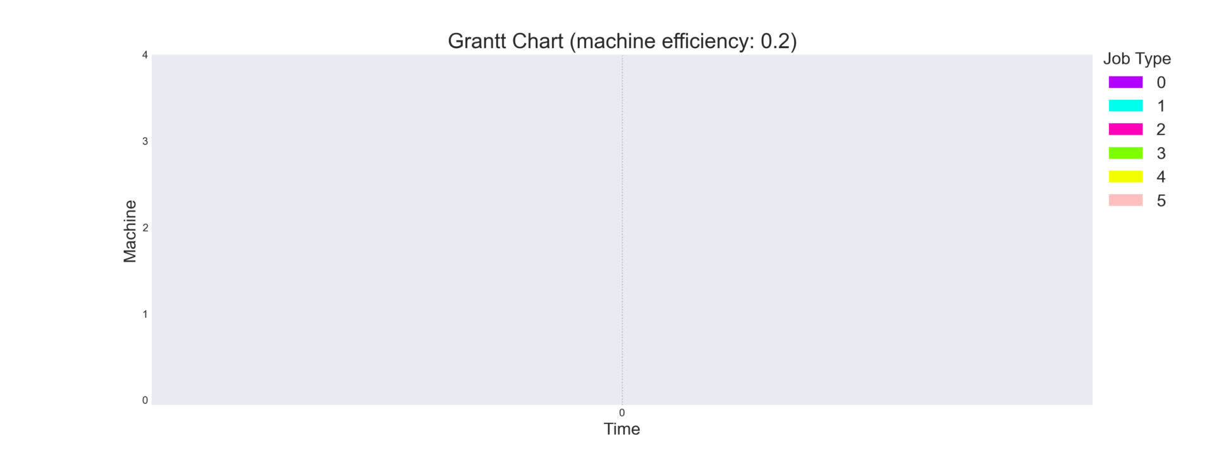

2.d. Job-Shop Scheduling Results (Deep Q-Network)
Applications
5 machines & 6 job types
10 machines & 6 job types
training
Testing
29.04.2022
11

Slide 11
3. Future Works
Run more experiments
Academic paper
Microservice/Capability
Implement a real project
29.04.2022
12

Slide 12
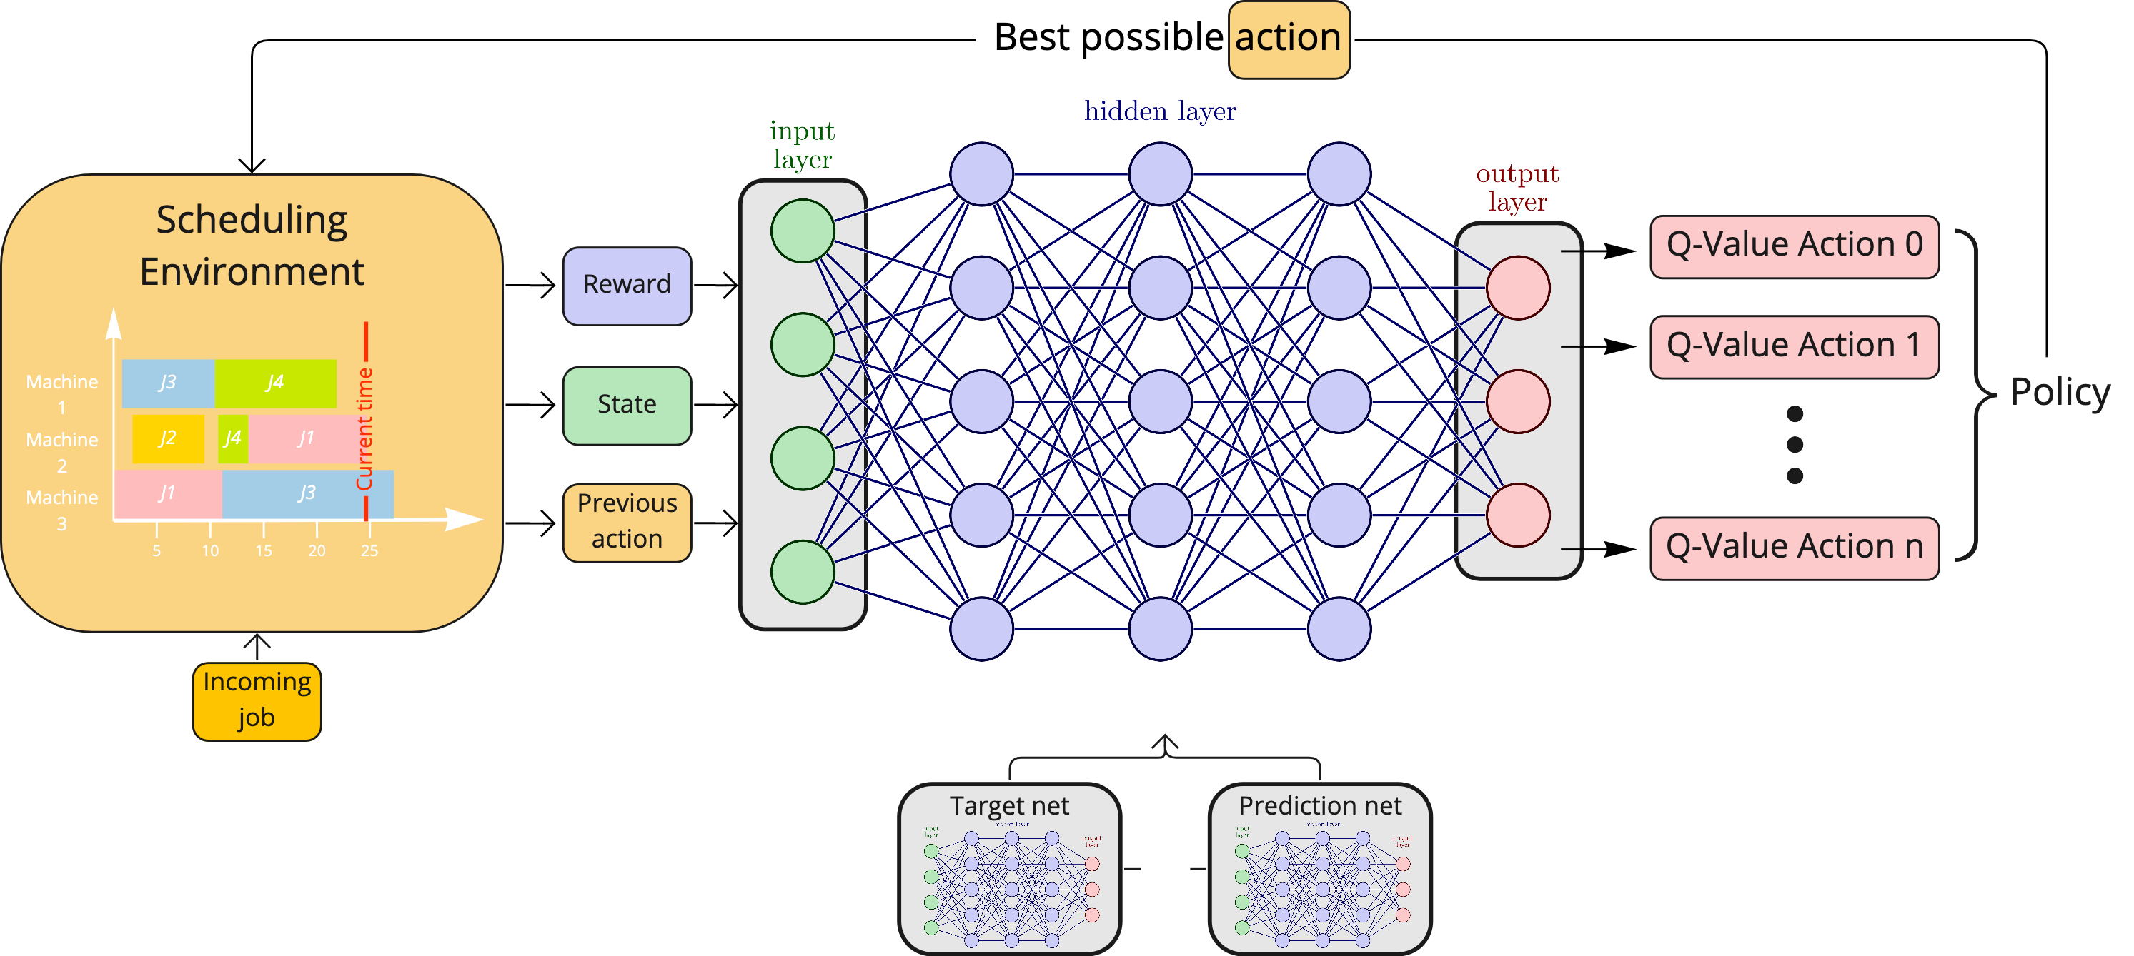
2.c. Job-Shop Scheduling Architecture (Deep Q-Network)
Applications
29.04.2022
12

